Slide 1

Preschool Daycare
Team
Chinmay Ashtikar (002115658) ashtikar.c@northeastern.edu
Erarica Mehra (002113683) mehra.e@northeastern.edu
Pratik Nakave (001305902) nakave.pr@northeastern.edu
Ruchika Sharma (002196636) sharma.ruc@northeastern.edu
Shrusti Chheda (002196756) chheda.sh@northeastern.edu

Slide 2
Notable Design points
MVC Design Pattern
Factory Design Pattern
Database Integration (MySQL)
GUI using Java Swing
Java SE

Slide 3

Operation instructions
Login to Daycare as admin
Dashboard with entity structure view
Entities supported:
Student : CRUD operations, search, sort, assignment based on state regulations
Teacher : CRUD operations, search, sort, assignment based on state regulations
Classroom : Displays groups & classroom logic
Feedback : Review teacher reviews
Tracking for student vaccination, student renewal

Slide 4
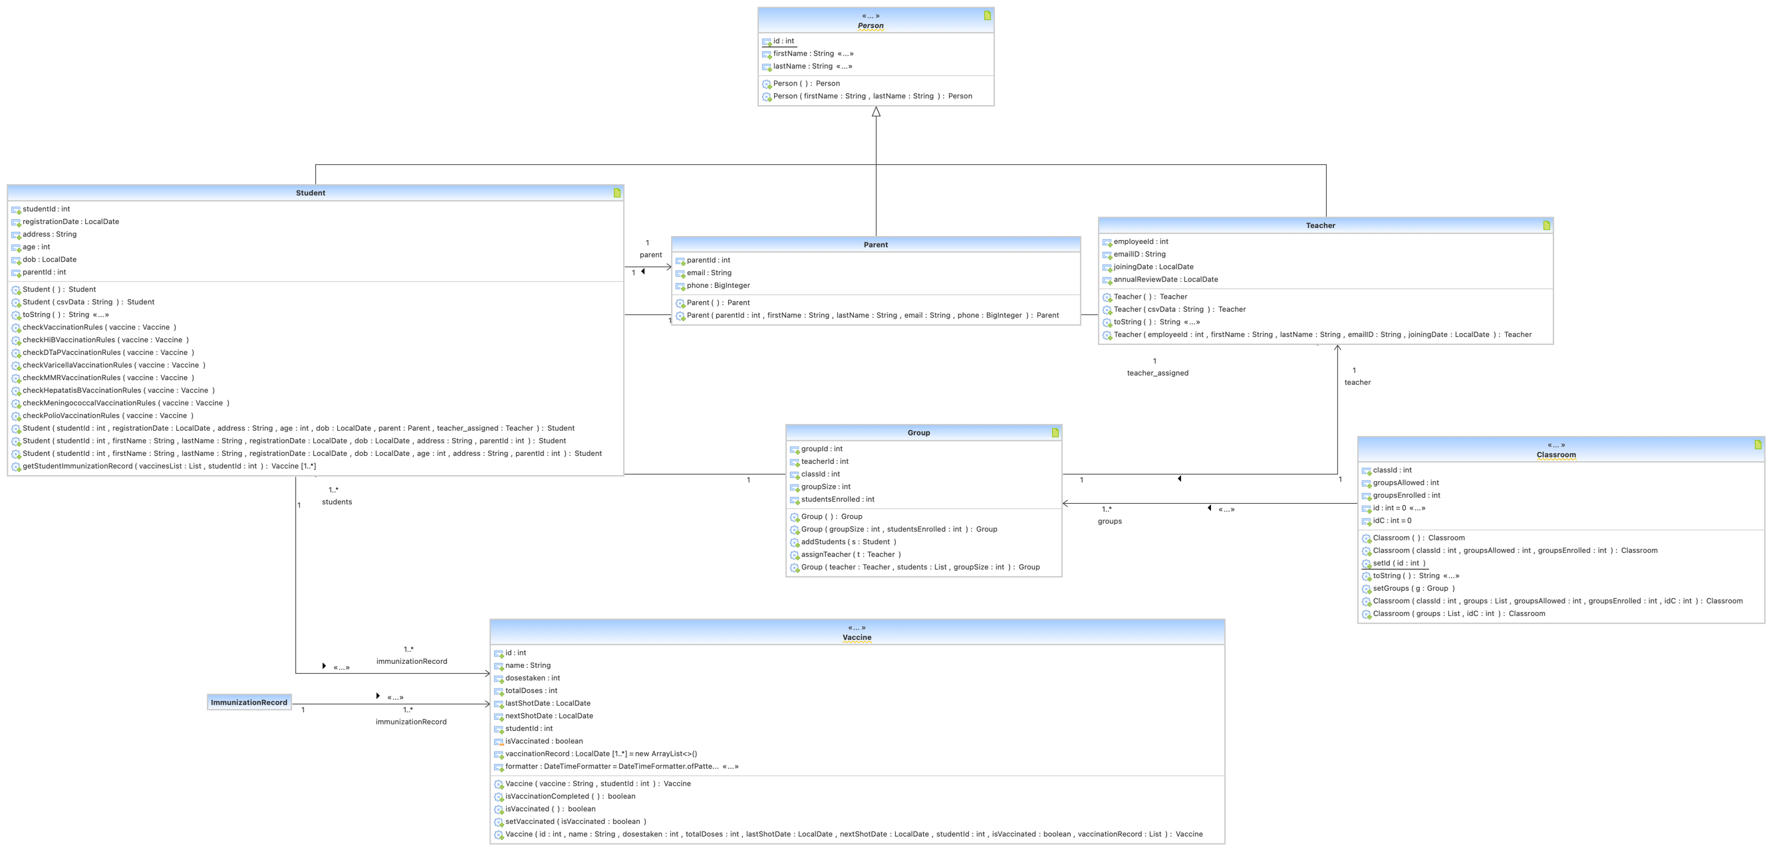
UML Diagrams

Slide 5
Applied Learning
OOD Principles (AIEP)
CSV Parsing
Lambdas
Streams
Factory methods
Swings
Threads
File I/O

Slide 6

Learning from research
Database Integration (MySQL)
Scheduler using ScheduledExecutorService and Cron Job for Email alerts, SMTP
External jars used:
AbsoluteLayout-RELEASE125.jar
activation-1.1.1.jar
javax.mail-1.6.2.jar
mysql-connector-java-8.0.27.jar
swingx-all-1.6.5-1.jar

Slide 7
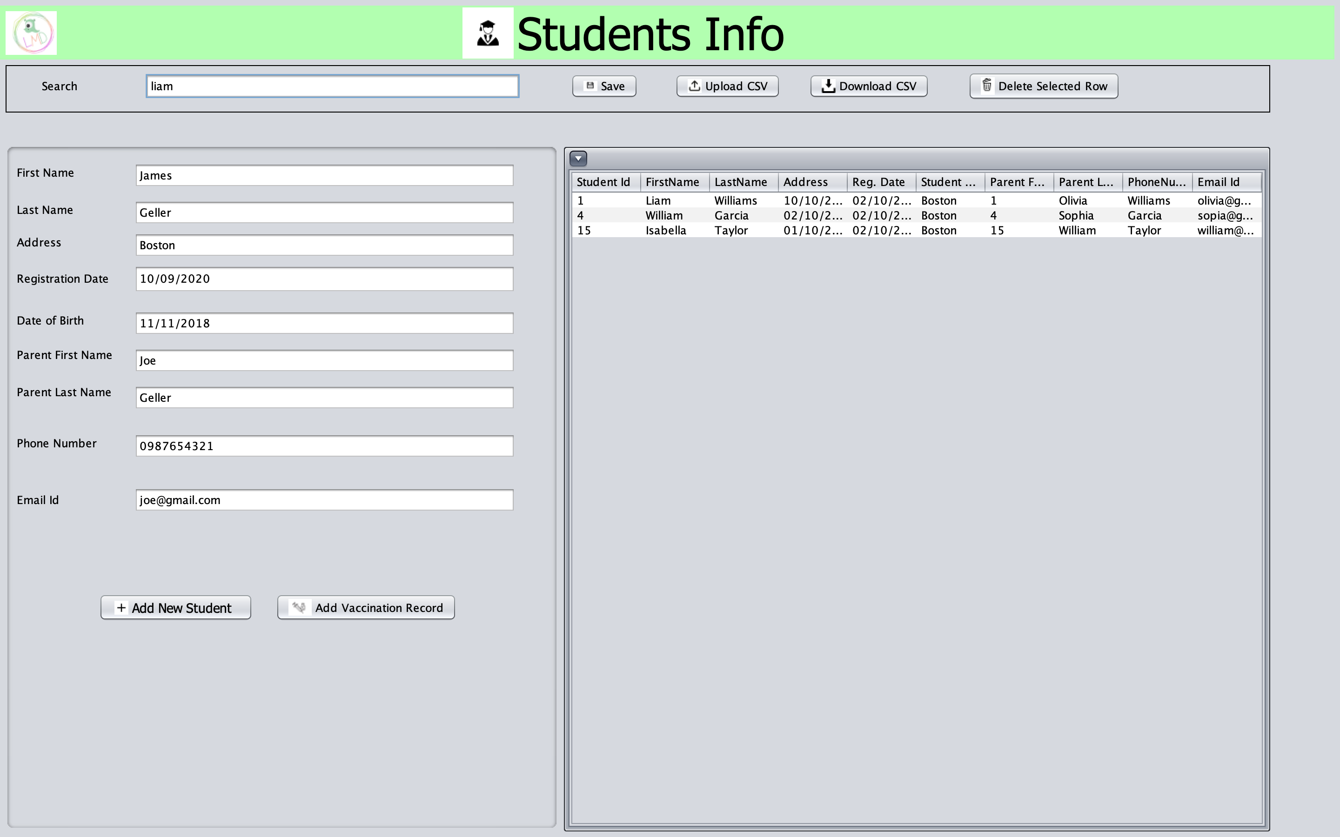
Student Registration
Created Student UI using swing
Display student and parent details in tabular format with functionalities like search and row sorting
Add student using form/csv
Allot group, teacher and classroom based on given rules
Created classroom UI to display class and group structure along with teachers allotted
Populate details in database
Integration of UI, backend and database

Slide 8
Teacher Enrollment and Annual Review
Created Teacher UI using swing
Display teacher details in tabular format with functionalities like search and row sorting
Add teacher using form/csv
Allot teacher to group based on given rules
Populate details in database
Integration of UI, backend and database
Created Feedback UI and email alerts for teacher annual review

Slide 9
Tracking
Vaccination
Add vaccination record for each student
Registration renewal
Track student registration date.
Feedback
Track employee joining date.
Track future doses based on student age, vaccination type and total number of doses to be administered.
Alerts for upcoming doses
Alerts for annual renewal
Alerts for annual review

Slide 10
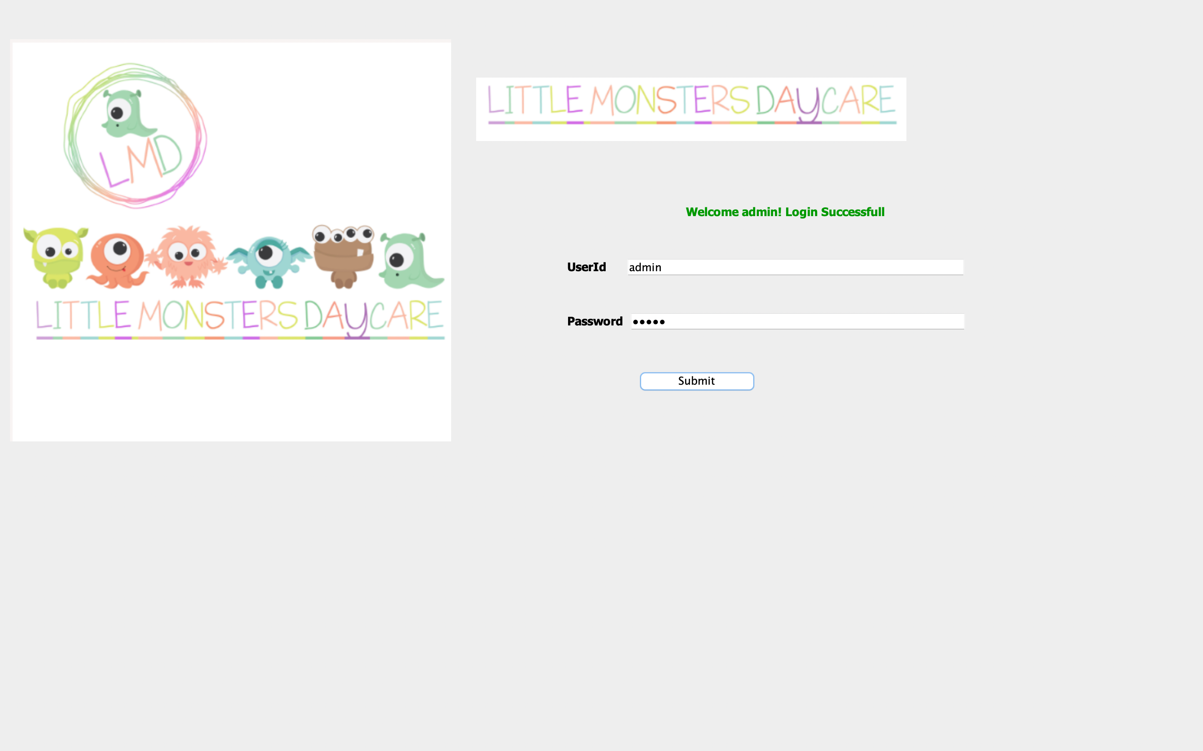
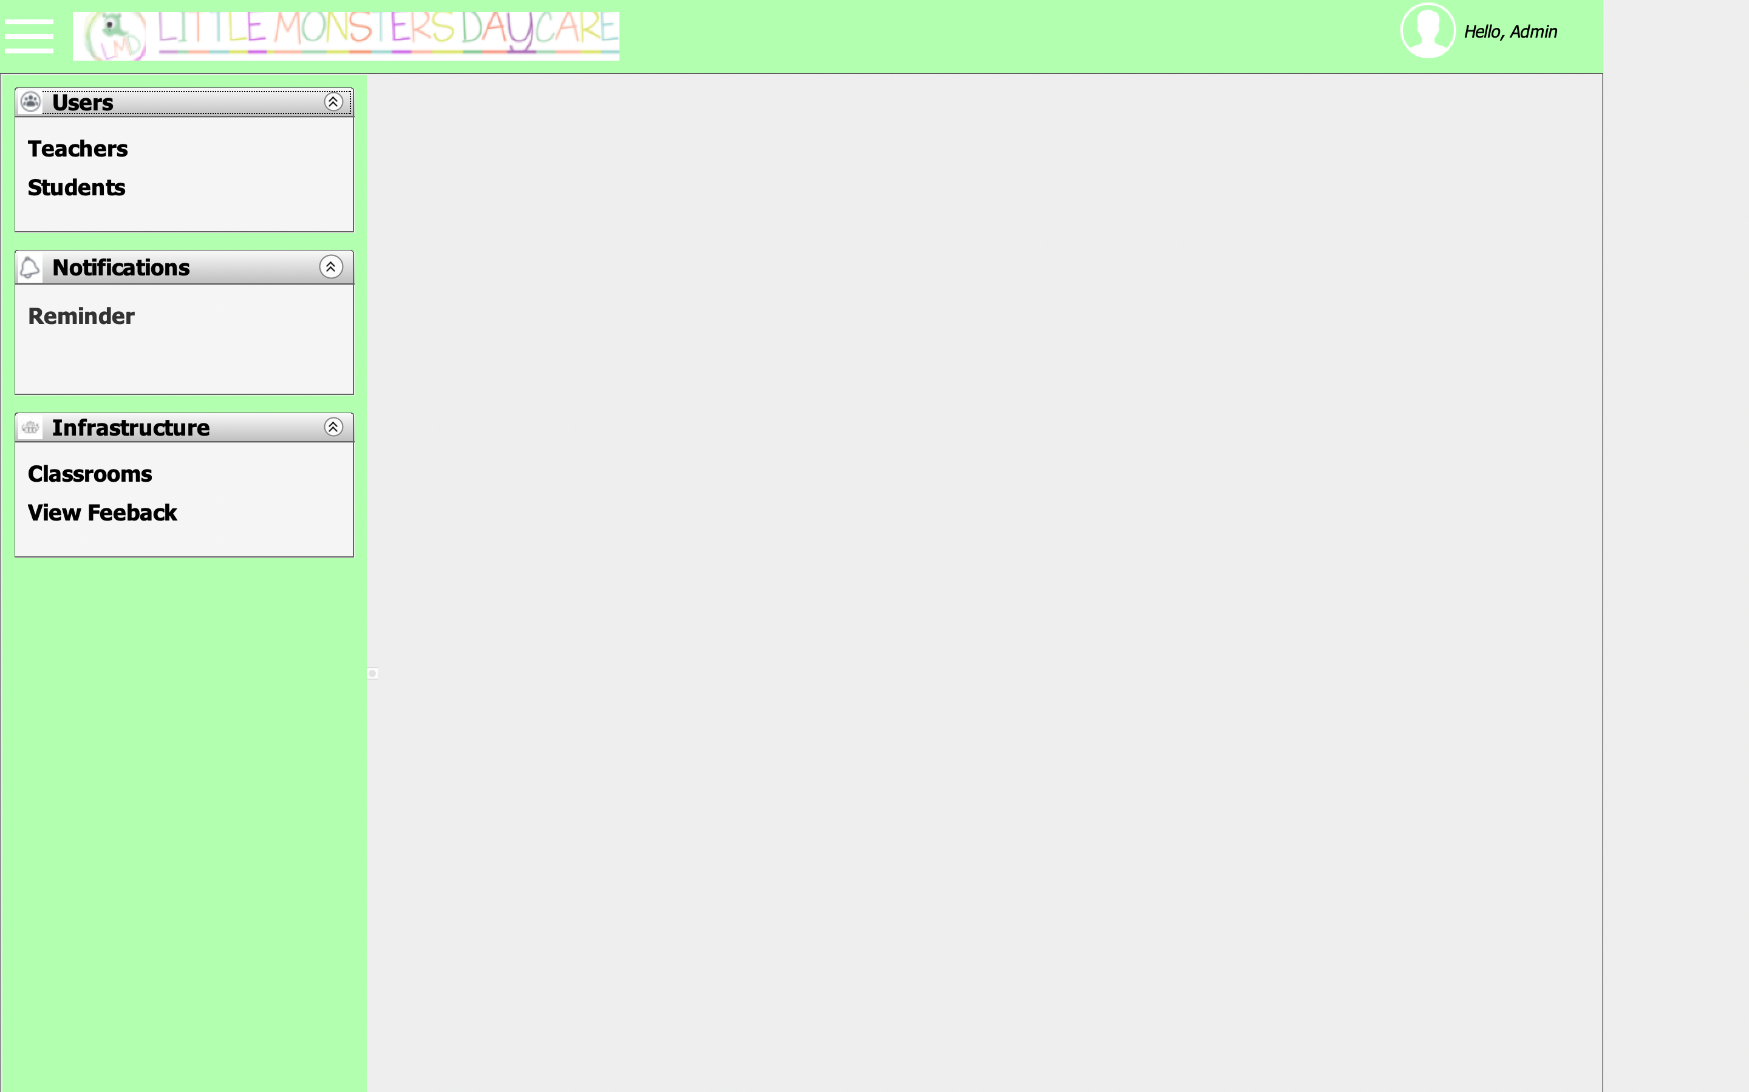
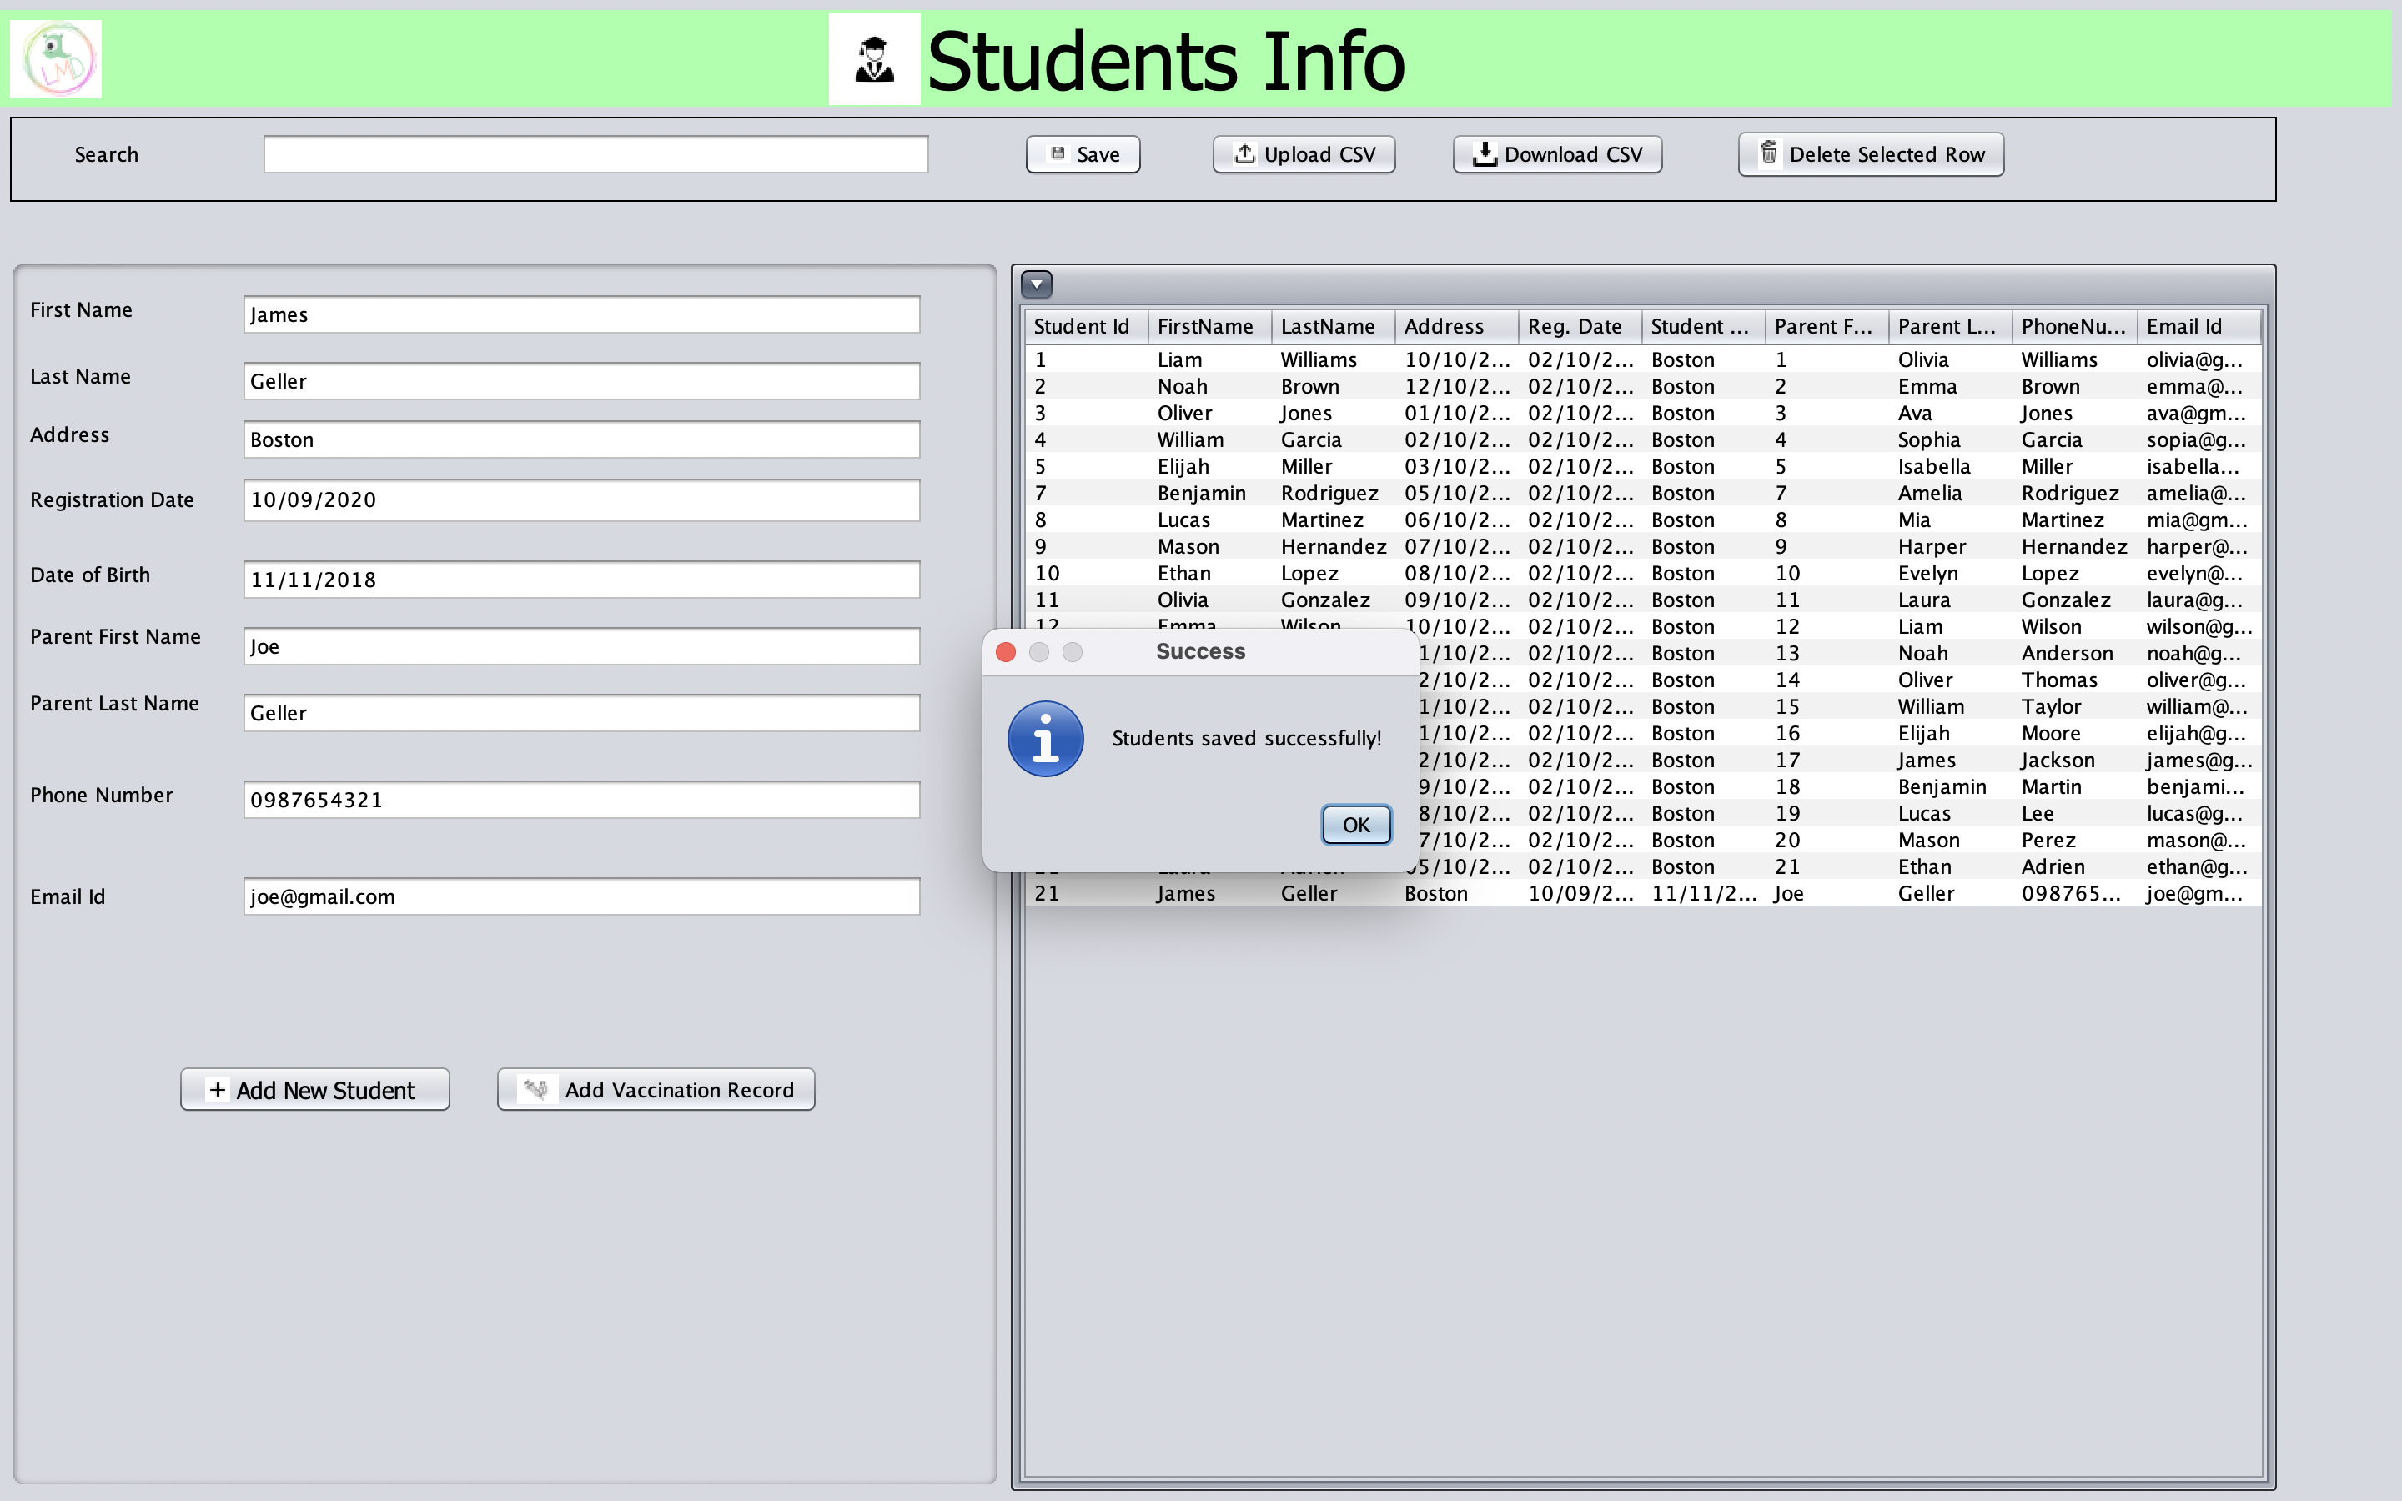
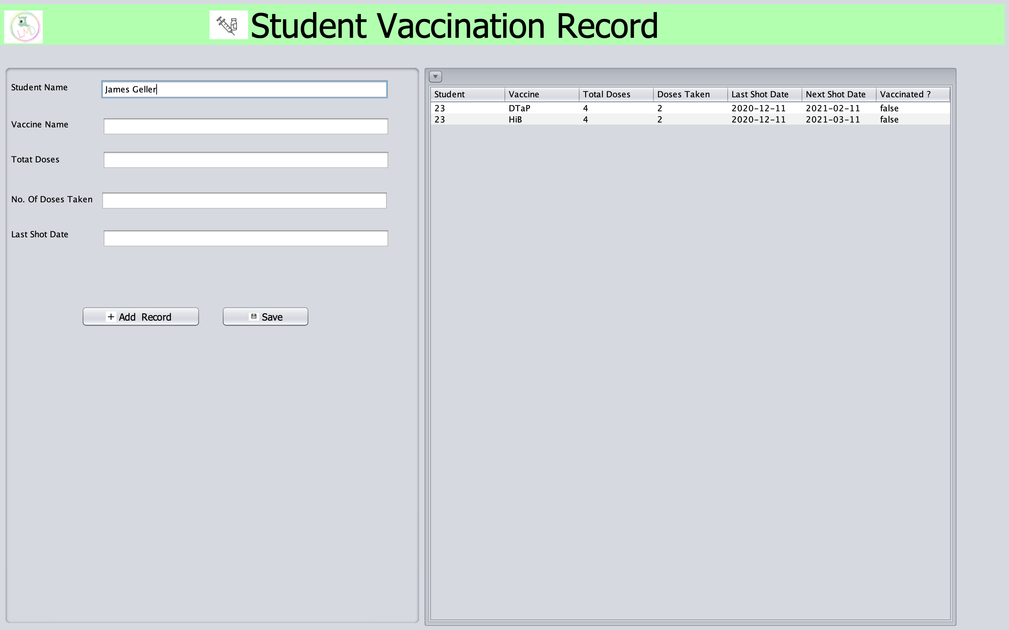

Slide 11
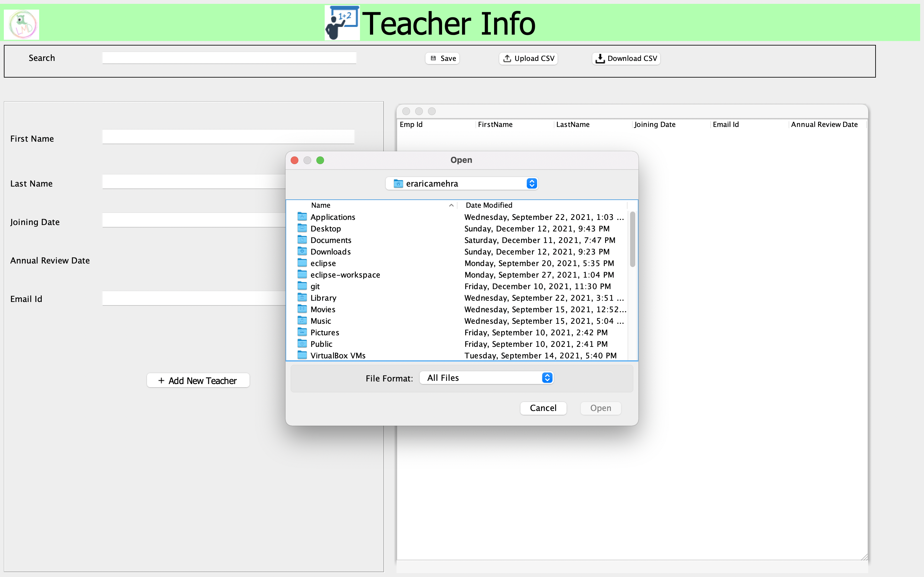
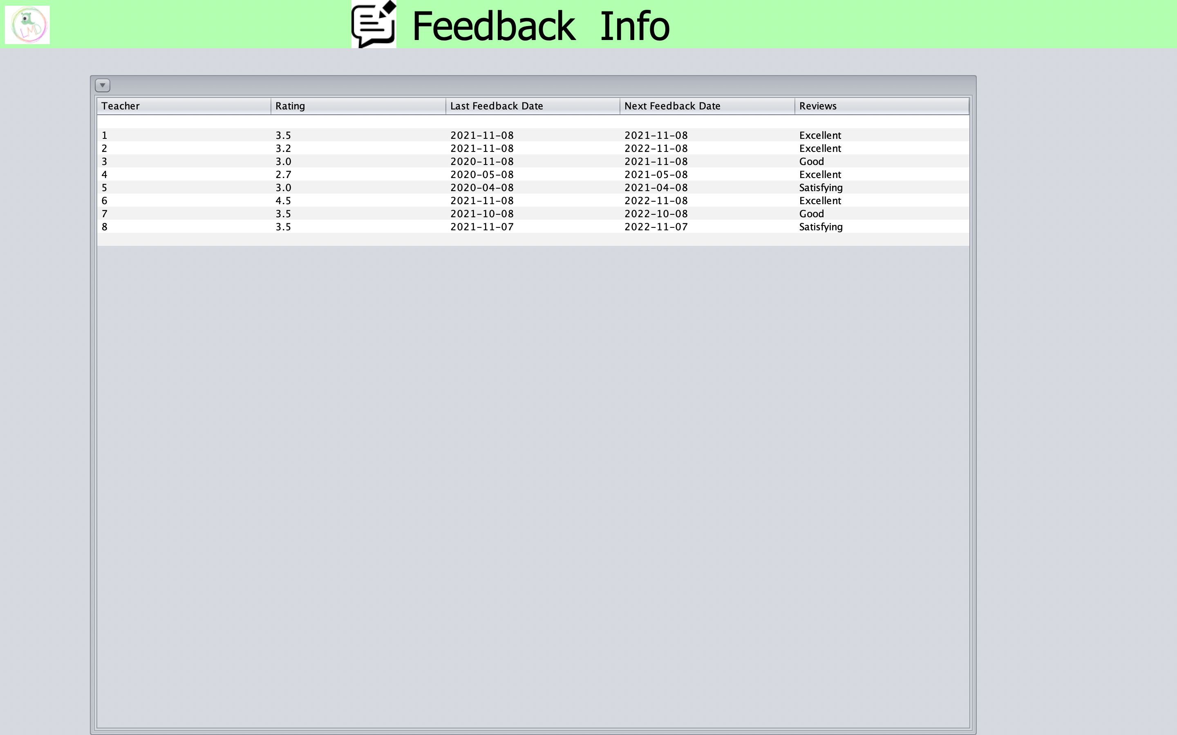
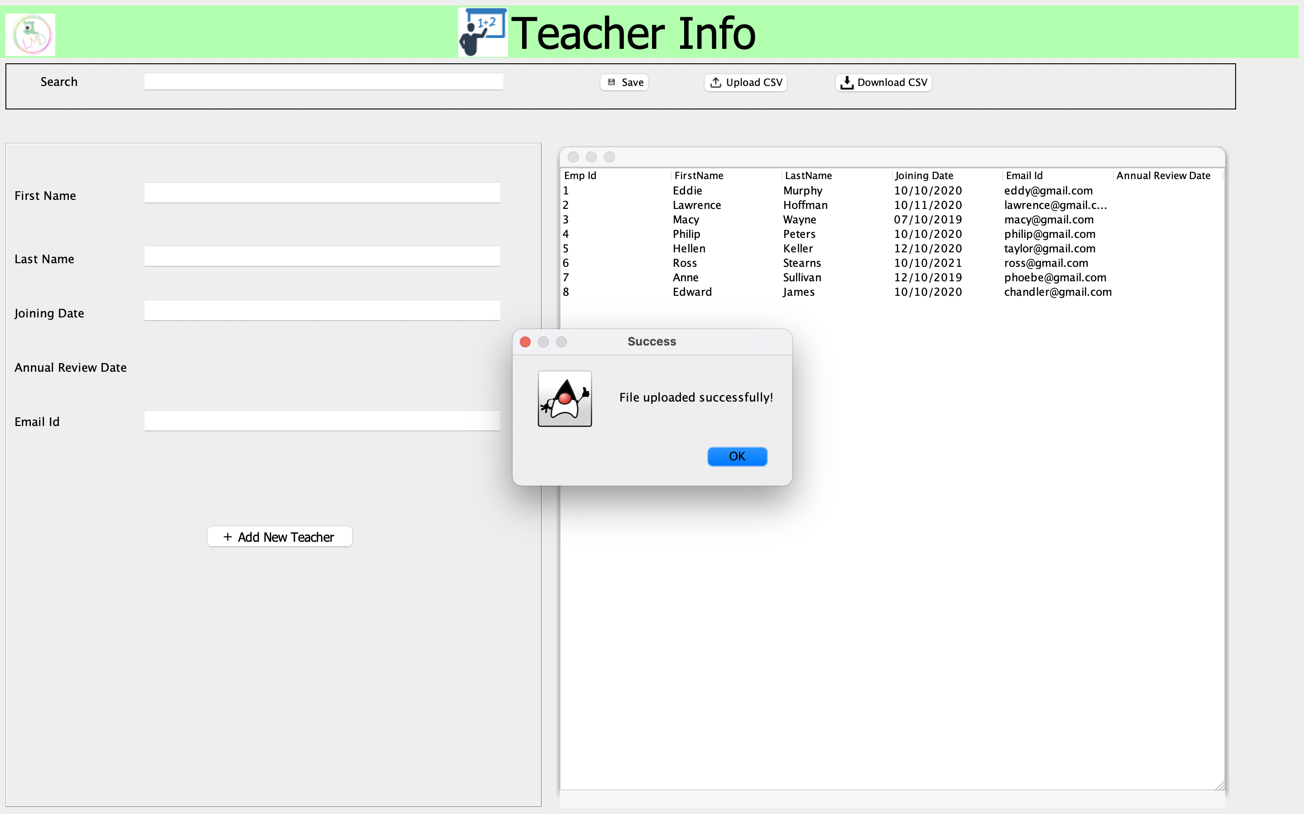
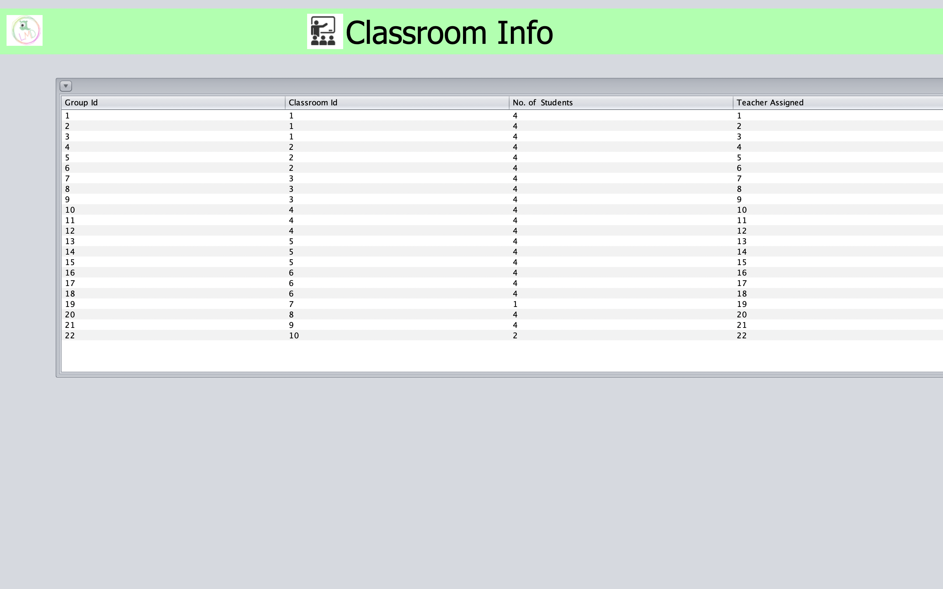

Slide 12
Individual Contribution
Chinmay Ashtikar – Frontend and UI design for Student, Teacher, Validation logic, UML
Erarica Mehra – MySQL integration, Email and Scheduler, Integration Testing, CRUD operations
Pratik Nakave– Grouping logic and ratio management, UI integration with backend, Integration Testing
Ruchika Sharma – Frontend and UI design for Student, Teacher, Landing page, Classroom, Vaccination
Shrusti Chheda – Vaccination implementation with rules and tracking, Testing, UML, Presentation

Slide 13
Future Enhancements
Implementing a Parent Login for Web Portal accessibility for Parents.
Maintaining a hierarchy structure between working staff and allotting roles-based access
Improving on the full stack architecture with an advanced functional UI
Deploying the system to take real-time advantage of schedulers

Slide 14
Thankyou

